Slide 1
Application of NLP
Dr. Chiranjib Sur
Mehta Family School of Data Science and Artificial Intelligence

Slide 2
What it is about ?
ZZZZZ Resources (NYSE:ZZZZZ) in their third quarter financials present a picture of a company with a relatively high amount of debt versus shareholder equity, and versus revenues. The company had total liabilities in the third quarter of $4,416 million versus shareholders' equity of only $1,518 million. That is a very high 3 to 1 debt to equity ratio. The company had third quarter revenues of $306 million. On an annualized basis, revenues would come out to $1,224 million. The company's debt level is almost 3 times its annual revenues. And remember, third quarter revenue is from before oil prices dropped in half. It looks like ZZZZZ may have bitten off more than it can chew.
XXXXX Petroleum (NYSE:XXXXX) is another company whose third quarter financials present a relatively high debt load. The company had total liabilities in the third quarter of $3,272 million versus shareholder equity of only $1,520 million. That represents a high 2 to 1 debt to equity ratio. The company had third quarter revenues of $350 million. On an annualized basis revenues would come out to $1,400 million. The company's debt is more than 2 times its annual revenue. While XXXXX is a very good operator, it looks like they have taken on the high debt strategy at the wrong time.
YYYYY Energy (NYSE:YYYYY) has a relatively high debt load according to their third quarter financials. The company had total liabilities of $2,026 million versus shareholder equity of $1,079. That is almost a 2 to 1 debt to equity ratio. Their third quarter revenues were $207 million. When annualized, their third quarter revenues come out to $827 million. The company's debt is almost 2 1/2 times its annualized revenues, and that is before the collapse of oil prices in the fourth quarter. YYYYY has taken the Brigham model to heart and has been aggressively growing the company.

Slide 3
Understanding a News Story
Opposition lawmakers in Poland have been occupying parliament for three weeks in a protest against the government. Frantic efforts are now being made to end the crisis before the next plenary session on Wednesday.
Almost all of Poland's important party leaders met on Monday at the invitation of the president of the senate to try to find a solution to the parliamentary crisis. Jaroslaw Kaczynski, the head of the governing national-conservative Law and Justice Party (PiS), also took part. The PiS is clearly trying to displace the conflict to a secondary theater - the senate, Poland's upper house of parliament.
However, Grzegorz Schetyna, the head of the biggest opposition party, the PO, steered clear of what he referred to as an "absurd" meeting. He said that instead he expected the PiS speaker of the lower house to "return to the [lower house's] plenary assembly hall." After all, he said, the conflict had not begun in the senate. The leader of the other liberal opposition party, Modern, did take part in the meeting - which goes to show once again how divided the opposition is.
Over the past few weeks, Poland has been caught up in a fight between the national-conservative government and the liberal opposition. The crisis began on December 16 with the announcement by the governing PiS that they would be restricting media access to parliament. The fight escalated inside the parliament - among other things, a group of opposition representatives occupied the rostrum in the plenary chamber. The government's parliamentary party left the chamber and "passed" the 2017 budget in an adjacent room. The main bone of contention now is whether this improvised vote, by a show of hands, was legitimate or not. Ultimately, the issue at stake is whether a parliamentary party with a small absolute majority, like the PiS, has to stick to the rules, or whether it can casually set them aside.
http://www.dw.com/en/is-there-a-resolution-to-polands-parliamentary-crisis/a-37070705
Notes:
http://www.bbc.com/news/world-latin-america-28829694

Slide 4
Understanding a News Story
Opposition lawmakers in Poland have been occupying parliament for three weeks in a protest against the government. Frantic efforts are now being made to end the crisis before the next plenary session on Wednesday.
Almost all of Poland's important party leaders met on Monday at the invitation of the president of the senate to try to find a solution to the parliamentary crisis. Jaroslaw Kaczynski, the head of the governing national-conservative Law and Justice Party (PiS), also took part. The PiS is clearly trying to displace the conflict to a secondary theater - the senate, Poland's upper house of parliament.
However, Grzegorz Schetyna, the head of the biggest opposition party, the PO, steered clear of what he referred to as an "absurd" meeting. He said that instead he expected the PiS speaker of the lower house to "return to the [lower house's] plenary assembly hall." After all, he said, the conflict had not begun in the senate. The leader of the other liberal opposition party, Modern, did take part in the meeting - which goes to show once again how divided the opposition is.
Over the past few weeks, Poland has been caught up in a fight between the national-conservative government and the liberal opposition. The crisis began on December 16 with the announcement by the governing PiS that they would be restricting media access to parliament. The fight escalated inside the parliament - among other things, a group of opposition representatives occupied the rostrum in the plenary chamber. The government's parliamentary party left the chamber and "passed" the 2017 budget in an adjacent room. The main bone of contention now is whether this improvised vote, by a show of hands, was legitimate or not. Ultimately, the issue at stake is whether a parliamentary party with a small absolute majority, like the PiS, has to stick to the rules, or whether it can casually set them aside.
Why did I highlight some of the phrases above?
Notes:
http://www.bbc.com/news/world-latin-america-28829694

Slide 5
Highlighted Phrases
on Wednesday
January 11, 2017
the parliamentary crisis
What caused the crisis?
Jaroslaw Kaczyński
Former prime minister; brother of the former president
the PO
Platforma Obywatelska (Civic Platform)
he said
he = Grzegorz Schetyna
Modern
Nowoczesna (liberal political party)

Slide 6
Recent advances in molecular genetics have permitted the development of novel virus-based vectors for the delivery of genes and expression of gene products [6,7,8]. These live vectors have the advantage of promoting robust immune responses due to their ability to replicate, and induce expression of genes at high efficiency. Sendai virus is a member of the Paramyxoviridae family, belongs in the genus respirovirus and shares 60–80% sequence homology to human parainfluenza virus type 1 (HPIV-1) [9,10].
The viral genome consists of a negative sense, non-segmented RNA. Although Sendai virus was originally isolated from humans during an outbreak of pneumonitis [11] subsequent human exposures to Sendai virus have not resulted in observed pathology [12]. The virus is commonly isolated from mouse colonies and Sendai virus infection in mice leads to bronchopneumonia, causing severe pathology and inflammation in the respiratory tract. The sequence homology and similarities in respiratory pathology have made Sendai virus a mouse model for HPIV-1. Immunization with Sendai virus promotes an immune response in non-human primates that is protective against HPIV-1 [13,14] and clinical trials are underway to determine the efficacy of this virus for protection against HPIV-1 in humans [15]. Sendai virus naturally infects the respiratory tract of mice and recombinant viruses have been reported to efficiently transduce luciferase, lac Z and green fluorescent protein (GFP) genes in the airways of mice or ferrets as well as primary human nasal epithelial cells [16].
These data support the hypothesis that intranasal (i.n.) immunization with a recombinant Sendai virus will mediate heterologous gene expression in mucosal tissues and induce antibodies that are specific to a recombinant protein. A major advantage of a recombinant Sendai virus based vaccine is the observation that recurrence of parainfluenza virus infections is common in humans [12,17] suggesting that anti-vector responses are limited, making repeated administration of such a vaccine possible.
Named entities + variants (human parainfluenza virus type, HPIV-1)
Speculation (reported, suggesting)
Species (human)
Cell types (nasal epithelial cells )
Facts
References
Notes:
Surface layer
Linguistic layer
Metonymy – “The company said”
Attachment – “a year earlier”
Rhetorical/logical layer
Attribution – “according to First Call”
Pragmatic layer
Buy!?
Inferential/decision making layer
Are earning in line with analyst expectations?

Slide 7
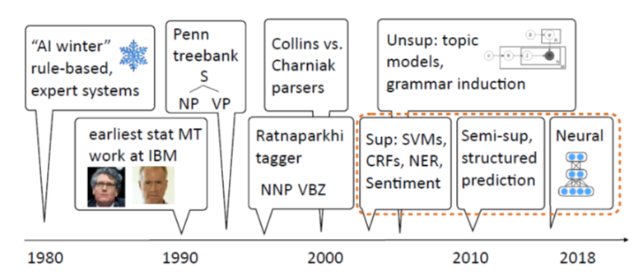
A Brief History of NLP
[Slide from Greg Durrett]

Slide 8
The Most Recent Years
Machine learning methods
SVM, logistic regression (maxent), CRFs (Conditional Random Fields)
Shared tasks (Conferences that Share NLP Tasks)
TREC, DUC, TAC, *SEM
Semantic tasks
RTE (Recognizing Textual Entailment), SRL (Semantic role labelling)
Semi-supervised and unsupervised methods
Zero-shot learning, transfer learning
Deep Learning
Embeddings, LSTM, CNN, Attention, GANs, Transformers

Slide 9
Types of Ambiguity
Morphological:
Joe is quite impossible. Joe is quite important.
Phonetic:
Joe’s finger got number.
Part of speech:
Joe won the first round.
Syntactic:
Call Joe a taxi.
Prepositional phrase attachment:
Joe ate pizza with a fork / with meatballs / with Samantha / with pleasure.
Sense:
Joe took the bar exam.
Notes:
Check if this example is not from Jurafsky

Slide 10
Other Sources of Difficulty
Subjectivity:
Joe believes that stocks will rise.
Cc attachment:
Joe likes ripe apples and pears.
Negation:
Joe likes his pizza with no cheese and tomatoes.
Referential:
Joe yelled at Mike. He had broken the bike.
Joe yelled at Mike. He was angry at him.
Reflexive:
John bought him a present.
John bought himself a present.
Ellipsis and parallelism:
Joe gave Mike a beer and Jeremy a glass of wine.
Metonymy:
Boston called and left a message for Joe.
Notes:
Check if this example is not from Jurafsky

Slide 11
Other Sources of Difficulties
Non-standard, slang, and novel words and usages
A360, 7342.67, +1-646-555-2223
“spam” or “friend” as verbs
yolo, selfie, chillax – recently recognized as dictionary words
www.urbandictionary.com – (Parental Warning!)
Inconsistencies
junior college, college junior
pet spray, pet llama
Typoes and gramattical erorz ☺
reciept, John Hopkins, should of
Parsing problems
Selbständigkeit (self-reliance)
cup holder
Federal Reserve Board Chairman

Slide 12
Other Sources of Difficulties
Complex sentences
Counterfactual sentences
Humor and sarcasm
Implicature/inference/world knowledge:
I was late because my car broke down.
Implies I have a car, I use the car to get to places, the car has wheels, etc.
What is not explicitly mentioned, what is world knowledge?
Semantics vs. pragmatics
Do you know the time?
Language is hard even for humans
Both first language and second language

Slide 13
Synonyms and Paraphrases
The S&P 500 climbed 6.93, or 0.56 percent, to 1,243.72, its best close since June 12, 2001.
The Nasdaq gained 12.22, or 0.56 percent, to 2,198.44 for its best showing since June 8, 2001.
The DJIA rose 68.46, or 0.64 percent, to 10,705.55, its highest level since March 15.

Slide 14
Synonyms and Paraphrases
The S&P 500 climbed 6.93, or 0.56 percent, to 1,243.72, its best close since June 12, 2001.
The Nasdaq gained 12.22, or 0.56 percent, to 2,198.44 for its best showing since June 8, 2001.
The DJIA rose 68.46, or 0.64 percent, to 10,705.55, its highest level since March 15.

Slide 15
NLP Tasks
Dr. Chiranjib Sur
Mehta Family School of Data Science and Artificial Intelligence

Slide 16
Part of Speech Tagging
The swimmer is getting ready to run in the final race.
Run – verb or noun?
Final – noun or adjective?
Race – verb or noun?
Notes:
JM slide?

Slide 17
Parsing
Myriam slept.
Myriam wrote a novel.
Myriam gave Sally flowers.
Myriam ate pizza with olives.
Myriam ate pizza with Sally.
Myriam ate pizza with a fork.
Myriam ate pizza with remorse.
Notes:
从句法上分析，对…进行语法分析。

Slide 18
Phrase-Structure Grammar
S → NP VP NP → DET N NP → NP PP VP → VBD VP → VBD NP VP → VBD NP NP VP → VP PP PP → PRP NP
DET → the DET → that DET → a N → child N → window N → car VBD → found VBD → ate VBD → saw PRP → in PRP → of PRP → through
Notes:
CHECK

Slide 19
Parse Trees
S
NP
VP
DET
N
VBD
NP
PP
The
child
saw
DET
N
PRP
NP
the
car
through
DET
N
the
window
Notes:
JM?

Slide 20
This Problem is Pretty // Easy
Commercial for a phone company
Garden path sentences
Don’t bother coming
Don’t bother coming early
Take the turkey out of the oven at five
Take the turkey out of the over at five to four
I got canned
I got canned peaches for dinner
All Americans need to buy a house
All Americans need to buy a house is a lot of money
Can you think of more such examples?

Slide 21
Information Extraction
RESEARCH ALERT-Wells Fargo cuts PPD Inc to market perform
China Southern Air Upgraded To Overweight From Neutral-HSBC
CITIGROUP RAISES INGERSOLL RAND <IR.N> TO HOLD FROM SELL
TCF Financial Corp Raised To Overweight From Neutral By JPMorgan
BAIRD CUTS KIOR INC <KIOR.O> TO UNDERPERFORM RATING
BRIEF-RESEARCH ALERT-Global Equities Research cuts LinkedIn to equal weight

Slide 22
Information Extraction
DATE/TIME | TICKER | COMPANY | SOURCE | OLD | NEW | CHANGE
 |  | PPD Inc | Wells Fargo |  | market perform
 |  | China Southern Air | HSBC | Neutral | Overweight
 | IR.N | INGERSOLL RAND | CITIGROUP | SELL | HOLD
 |  | TCF Financial Corp | JPMorgan | Neutral | Overweight
 | KIOR.O | KIOR INC | BAIRD |  | UNDERPERFORM
 |  | LinkedIn | Global Equities Research |  | equal weight

Slide 23
Text Understanding
There are four bungalows in our cul-de-sac. They are made from these materials: straw, wood, brick and glass. Mrs. Scott's bungalow is somewhere to the left of the wooden one and the third one along is brick. Mrs. Umbrella owns a straw bungalow and Mr. Tinsley does not live at either end, but lives somewhere to the right of the glass bungalow. Mr. Wilshaw lives in the fourth bungalow, whilst the first bungalow is not made from straw. Who lives where, and what is their bungalow made from?
http://www.brainbashers.com/showpuzzles.asp?puzzle=ZSOP

Slide 24
Word Sense Disambiguation
“The thieves took off with 100 gold bars”.
Did they steal 100 drinking establishments?
Or 100 measures of a song?

Slide 25
Word Sense Disambiguation
Bar=Noun
S: (n) barroom, bar, saloon, ginmill, taproom (a room or establishment where alcoholic drinks are served over a counter) "he drowned his sorrows in whiskey at the bar"
S: (n) bar (a counter where you can obtain food or drink) "he bought a hot dog and a coke at the bar"
S: (n) bar (a rigid piece of metal or wood; usually used as a fastening or obstruction or weapon) "there were bars in the windows to prevent escape"
S: (n) measure, bar (musical notation for a repeating pattern of musical beats) "the orchestra omitted the last twelve bars of the song"
S: (n) bar (an obstruction (usually metal) placed at the top of a goal) "it was an excellent kick but the ball hit the bar"
S: (n) prevention, bar (the act of preventing) "there was no bar against leaving"; "money was allocated to study the cause and prevention of influenza"
S: (n) bar ((meteorology) a unit of pressure equal to a million dynes per square centimeter) "unfortunately some writers have used bar for one dyne per square centimeter"
S: (n) bar (a submerged (or partly submerged) ridge in a river or along a shore) "the boat ran aground on a submerged bar in the river"
S: (n) legal profession, bar, legal community (the body of individuals qualified to practice law in a particular jurisdiction) "he was admitted to the bar in New Jersey"
S: (n) stripe, streak, bar (a narrow marking of a different color or texture from the background) "a green toad with small black stripes or bars"; "may the Stars and Stripes forever wave"
S: (n) cake, bar (a block of solid substance (such as soap or wax)) "a bar of chocolate"
S: (n) Browning automatic rifle, BAR (a portable .30 caliber automatic rifle operated by gas pressure and fed by cartridges from a magazine; used by United States troops in World War I and in World War II and in the Korean War)
S: (n) bar (a horizontal rod that serves as a support for gymnasts as they perform exercises)
S: (n) bar (a heating element in an electric fire) "an electric fire with three bars"
S: (n) bar ((law) a railing that encloses the part of the courtroom where the judges and lawyers sit and the case is tried) "spectators were not allowed past the bar"
Bar=Verb
S: (v) bar, debar, exclude (prevent from entering; keep out) "He was barred from membership in the club"
S: (v) barricade, block, blockade, stop, block off, block up, bar (render unsuitable for passage) "block the way"; "barricade the streets"; "stop the busy road"
S: (v) banish, relegate, bar (expel, as if by official decree) "he was banished from his own country"
S: (v) bar (secure with, or as if with, bars) "He barred the door"

Slide 26
Named Entity Recognition
Wolff B-PER
, O
currently O
a O
journalist O
in O
Argentina B-LOC
, O
played O
with O
Del B-PER
Bosque I-PER
in O
the O
final O
years O
of O
the O
seventies O
in O
Real B-ORG
Madrid I-ORG
. O
Wolff, currently a journalist in Argentina, played with Del Bosque in the final years of the seventies in Real Madrid.
http://cogcomp.cs.illinois.edu/page/demo_view/NER
http://nlp.stanford.edu:8080/ner/

Slide 27
Semantic Role Labeling
[_{A0} He ] [_{AM-MOD} would ] [_{AM-NEG} n't ] [_{V} accept ] [_{A1} anything of value ] from [_{A2} those he was writing about ] .
V: verb A0: acceptor A1: thing accepted A2: accepted-from A3: attribute AM-MOD: modal AM-NEG: negation
http://cogcomp.cs.illinois.edu/page/demo_view/SRL

Slide 28
Coreference Resolution
Coreference resolution is the task of finding all expressions that refer to the same entity in a text.
Barack Obama visited China. The US president met with his Chinese counterpart.
Cynthia went to see her aunt at the hospital. She was scheduled for surgery on Monday.
Because he was sick, Michael stayed home on Friday.

Slide 29
Sentiment Analysis
“I like the camera because I can edit images so easily, exactly as I do my iPad. I have found that its difficult to frame a picture when there isn't a zoom function as with the iPad. With this camera I can adjust my images by cropping as I did with my iPad but better yet, this camera has a built in zoom. A stretch or pinch of the fingers bring in the subject closer or back out again. With this iPhone I can also, as I dido with my iPad, enhance, crop, rotate, red eye reduce, and set a range of tints. I am also quite impressed with the quality of the images. Pretty darn good especially better than I expected for low light situations where I can use the built-in flash! Quite frankly I was quite surprised with these built in features. I also hope too experiment with and learn what HDR photography is. It's built into this iPhone and can be activated by a the touch of an icon. ”
http://www.epinions.com/review/apple_iphone_5c_latest_model_16gb_graphite_unlocked_smartphone/content_640679317124

Slide 30
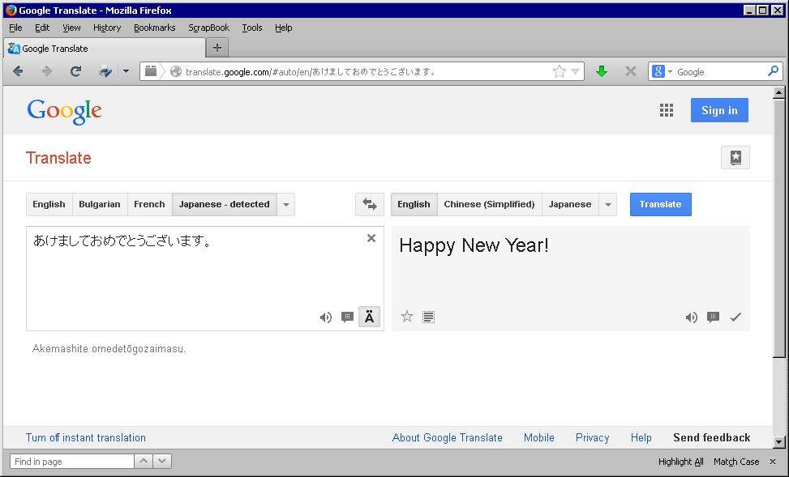
Machine Translation
あけましておめでとうございます。
Happy New Year!

Slide 31
Single Document Summarization
[Wei and Gao 2014]

Slide 32
Multi Document Summarization
Health Benefits
Eating a diet rich in vegetables and fruits as part of an overall healthy diet may reduce risk for heart disease, including heart attack and stroke.
Eating a diet rich in some vegetables and fruits as part of an overall healthy diet may protect against certain types of cancers.
Diets rich in foods containing fiber, such as some vegetables and fruits, may reduce the risk of heart disease, obesity, and type 2 diabetes.
Eating vegetables and fruits rich in potassium as part of an overall healthy diet may lower blood pressure, and may also reduce the risk of developing kidney stones and help to decrease bone loss.
Eating foods such as vegetables that are lower in calories per cup instead of some other higher-calorie food may be useful in helping to lower calorie intake.
Nutrients
Most vegetables are naturally low in fat and calories. None have cholesterol. (Sauces or seasonings may add fat, calories, or cholesterol.)
Vegetables are important sources of many nutrients, including potassium, dietary fiber, folate (folic acid), vitamin A, and vitamin C.
Diets rich in potassium may help to maintain healthy blood pressure. Vegetable sources of potassium include sweet potatoes, white potatoes, white beans, tomato products (paste, sauce, and juice), beet greens, soybeans, lima beans, spinach, lentils, and kidney beans.
Dietary fiber from vegetables, as part of an overall healthy diet, helps reduce blood cholesterol levels and may lower risk of heart disease. Fiber is important for proper bowel function. It helps reduce constipation and diverticulosis. Fiber-containing foods such as vegetables help provide a feeling of fullness with fewer calories.
Folate (folic acid) helps the body form red blood cells. Women of childbearing age who may become pregnant should consume adequate folate from foods, and in addition 400 mcg of synthetic folic acid from fortified foods or supplements. This reduces the risk of neural tube defects, spina bifida, and anencephaly during fetal development.
Vitamin A keeps eyes and skin healthy and helps to protect against infections.
Vitamin C helps heal cuts and wounds and keeps teeth and gums healthy. Vitamin C aids in iron absorption.

Slide 33
Summary
Eating vegetables is healthy.

Slide 34
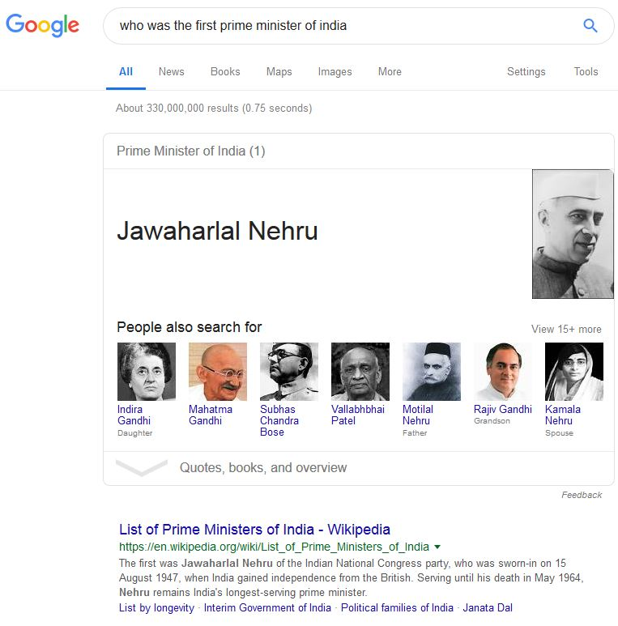
Question Answering

Slide 35
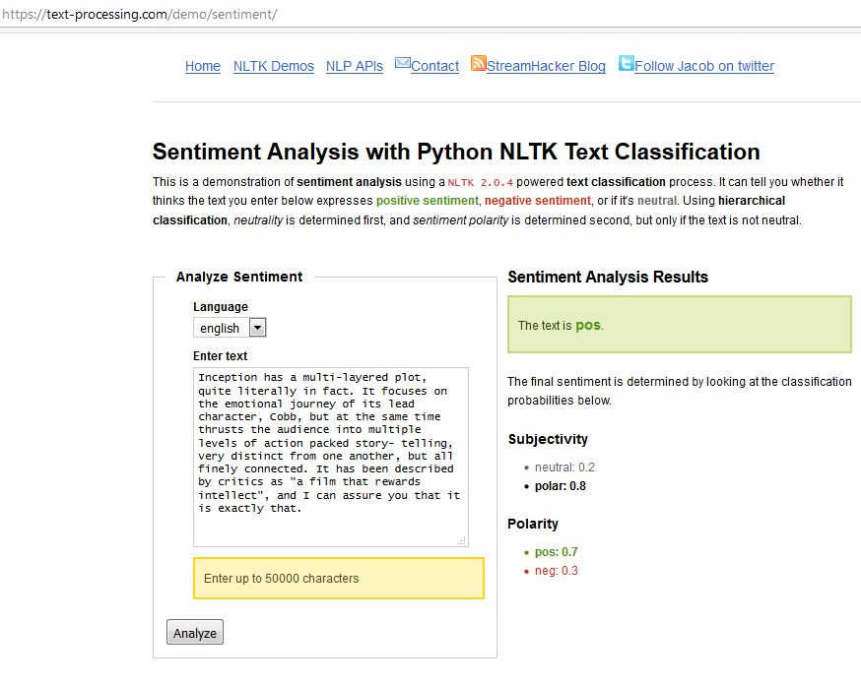
Sentiment Analysis

Slide 36
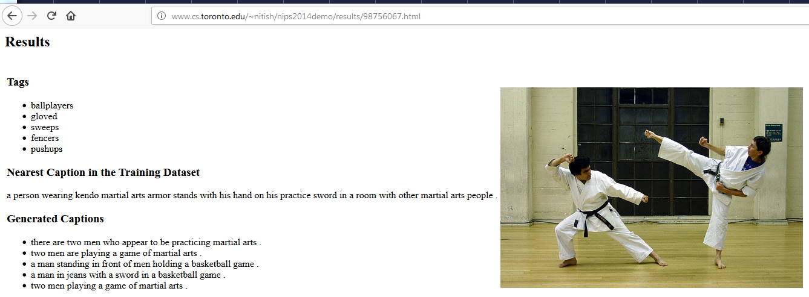
Caption Generation

Slide 37
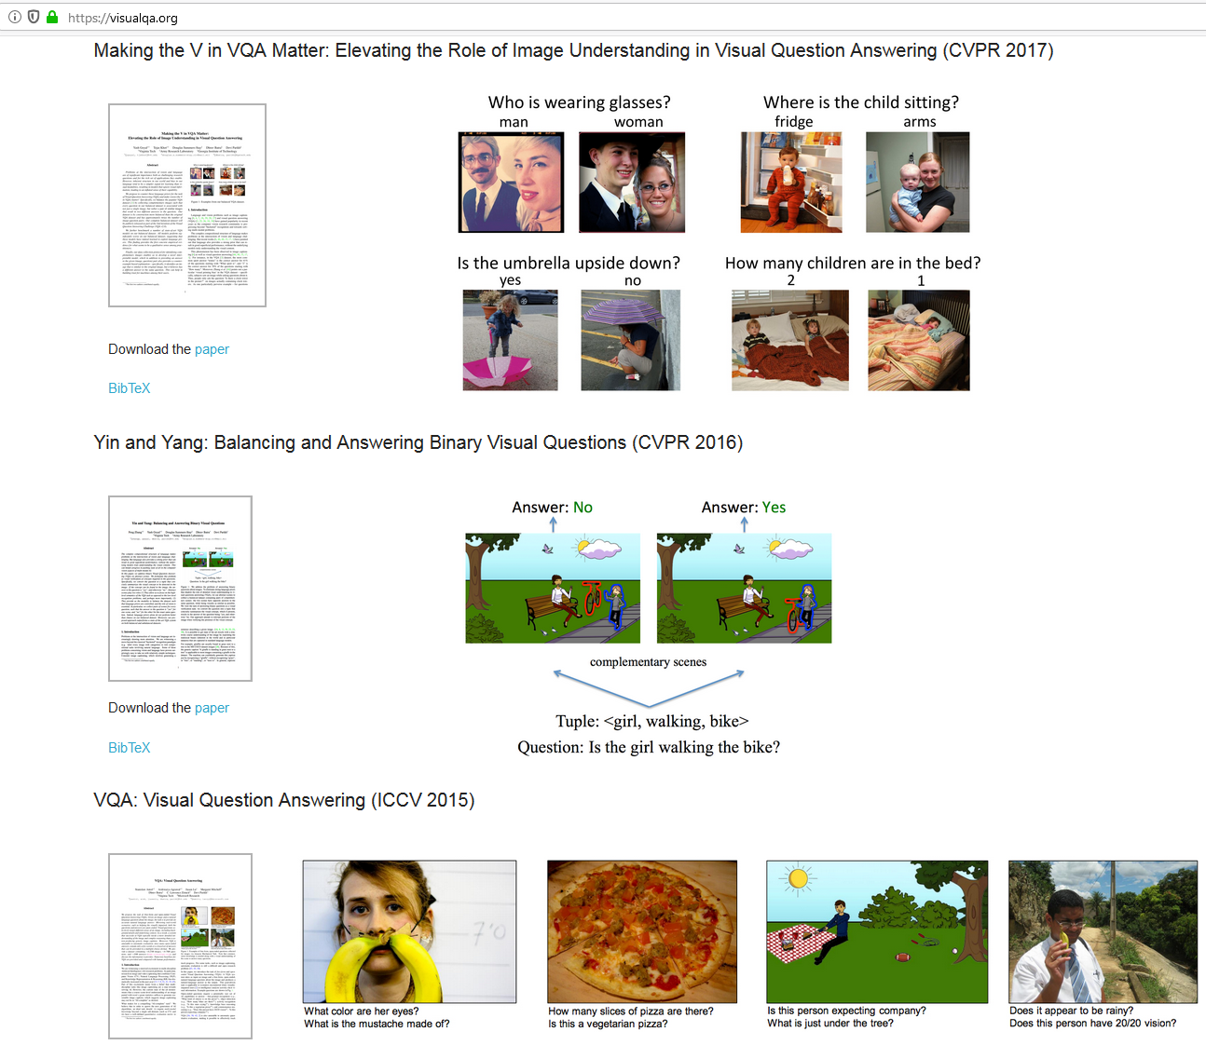
Visual Question Answering

Slide 38
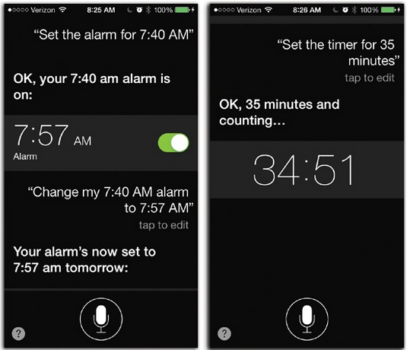
Conversational Agents
https://www.oreilly.com/library/view/iphone-the-missing/9781449372781/ch04.html

Slide 39
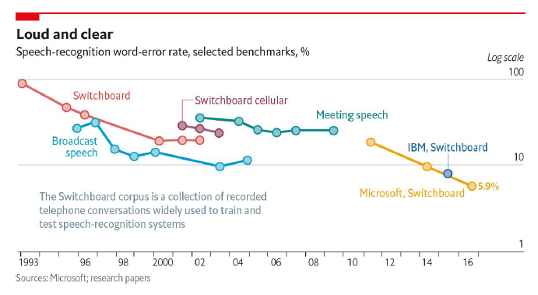
Speech Recognition

Slide 40
Dialogue Systems
I would like to make a reservation at Sorrento.
For when?
8 pm Friday night.
We only have availability for 7 pm and 10 pm.
Sorry, these don't work for me.
Notes:
CHECK PROVENANCE?

Slide 41
NLP Processing
Dr. Chiranjib Sur
Mehta Family School of Data Science and Artificial Intelligence

Slide 42
Text Preprocessing
Removing non-text
ads, javascript
Dealing with text encoding
e.g., Unicode
Sentence segmentation
later slide
Normalization
labeled/labelled, extra-terrestrial/extraterrestrial, extra terrestrial
Stemming
computer/computation, connected/connects/connect,
Lemmatization
is, am -> be
Morphological analysis
car/cars
Capitalization
Now/NOW, led/LED
Named entity extraction
USA/usa
Notes:
Poets, essayists, and novelists

Slide 43
Sentence segmentation into words
金属製品製造の日立金属は１９日、世界最大手の鉄鋳物メーカー「ワウパカ ファウンドリー ホールディングス」（米国・デラウェア州）を米投資ファンドから買収し、完全子会社にすると発表した。買収額は１３億ドル（約１３３０億円）で、１０月中にも手続きを終える。
Notes:
(Google Translate) The 19th, Hitachi Metals of fabricated metal products has announced the acquisition from the United States investment fund iron castings manufacturer in the world's largest "Waupaca Foundry Holdings" the (US-Delaware), while a wholly owned subsidiary. $ 1.3 billion (about 133 billion yen), purchase price to finish the procedure also in October.
Kinzoku seihin seizō no hitachikinzoku wa 19-nichi, sekai saiōte no tetsu imono mēkā `waupaka faundorī hōrudingusu'(Beikoku Derau~Ea-shū) o Amerika tōshi fando kara baishū shi, kanzen kogaisha ni suru to happyō shita. Baishū-gaku wa 13 oku-doru (yaku 1330 oku-en) de, 10 tsuki-chū ni mo tetsudzuki o oeru.
http://www.asahi.com/articles/ASG8M5GYTG8MULFA019.html?iref=comtop_6_06

Slide 44
Parts of speech
Dr. Chiranjib Sur
Mehta Family School of Data Science and Artificial Intelligence

Slide 45
The POS task
Example
Bahrainis vote in second round of parliamentary election
Jabberwocky (by Lewis Carroll, 1872)
`Twas brillig, and the slithy toves Did gyre and gimble in the wabe: All mimsy were the borogoves, And the mome raths outgrabe.

Slide 46
Penn Treebank tagset (1/2)
Tag | Description | Example
CC | coordinating conjunction | and
CD | cardinal number | 1
DT | determiner | the
EX | existential there | there is
FW | foreign word | d‘oeuvre
IN | preposition/subordinating conjunction | in, of, like
JJ | adjective | green
JJR | adjective, comparative | greener
JJS | adjective, superlative | greenest
LS | list marker | 1)
MD | modal | could, will
NN | noun, singular or mass | table
NNS | noun plural | tables
NNP | proper noun, singular | John
NNPS | proper noun, plural | Vikings
PDT | predeterminer | both the boys
POS | possessive ending | friend's

Slide 47
Penn Treebank tagset (2/2)
Tag | Description | Example
PRP | personal pronoun | I, he, it
PRP$ | possessive pronoun | my, his
RB | adverb | however, usually, naturally, here, good
RBR | adverb, comparative | better
RBS | adverb, superlative | best
RP | particle | give up
TO | to | to go, to him
UH | interjection | uhhuhhuhh
VB | verb, base form | take
VBD | verb, past tense | took
VBG | verb, gerund/present participle | taking
VBN | verb, past participle | taken
VBP | verb, sing. present, non-3d | take
VBZ | verb, 3rd person sing. present | takes
WDT | wh-determiner | which
WP | wh-pronoun | who, what
WP$ | possessive wh-pronoun | whose
WRB | wh-abverb | where, when

Slide 48
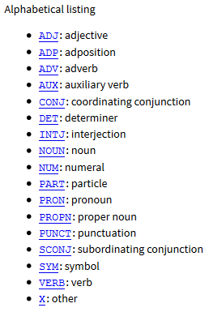
Universal POS
http://universaldependencies.org/u/pos/

Slide 49
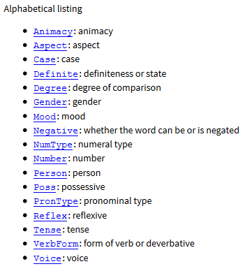
Universal Features
http://universaldependencies.org/u/feat/

Slide 50
Some Observations
Ambiguity
count (noun) vs. count (verb)
11% of all types but 40% of all tokens in the Brown corpus are ambiguous.
Examples
like can be tagged as ADP VERB ADJ ADV NOUN
present can be tagged as ADJ NOUN VERB ADV

Slide 51
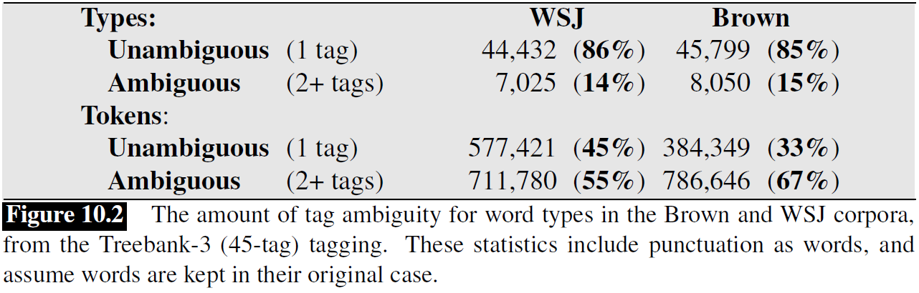
POS Ambiguity
Example from J&M

Slide 52
Sources of Information
Bethlehem/NNP Steel/NNP Corp./NNP ,/, hammered/VBN by/IN higher/JJR costs/NNS
Bethlehem/NNP Steel/NNP Corp./NNP ,/, hammered/VBN by/IN higher/JJR costs/VBZ
Knowledge about individual words
lexical information
spelling (-or)
capitalization (IBM)
Knowledge about neighboring words

Slide 53
Evaluation
Baseline
tag each word with its most likely tag
tag each OOV word as a noun.
around 90%
Current accuracy
around 97% for English
compared to 98% human performance

Slide 54
Rule-based POS tagging
Use dictionary or finite-state transducers to find all possible parts of speech
Use disambiguation rules
e.g., ART+V
Hundreds of constraints need to be designed manually

Slide 55
Thank You

